Slide 1
AIMS 1.5: Requesting NELP SPA Templates/Shells
Joan Auchter, NELP SPA Coordinator
February 15, 2025

Slide 2
CAEP REPORTS and SPA REPORTS
CAEP PROGRAM: AIMS 2.O
SPA PROGRAM: AIMS 1.5
CAEP program processes have migrated to AIMS 2.0
SPA program processes still operate in AIMS 1.5
No firm timeline for when SPA processes will migrate to 2.0

Slide 3
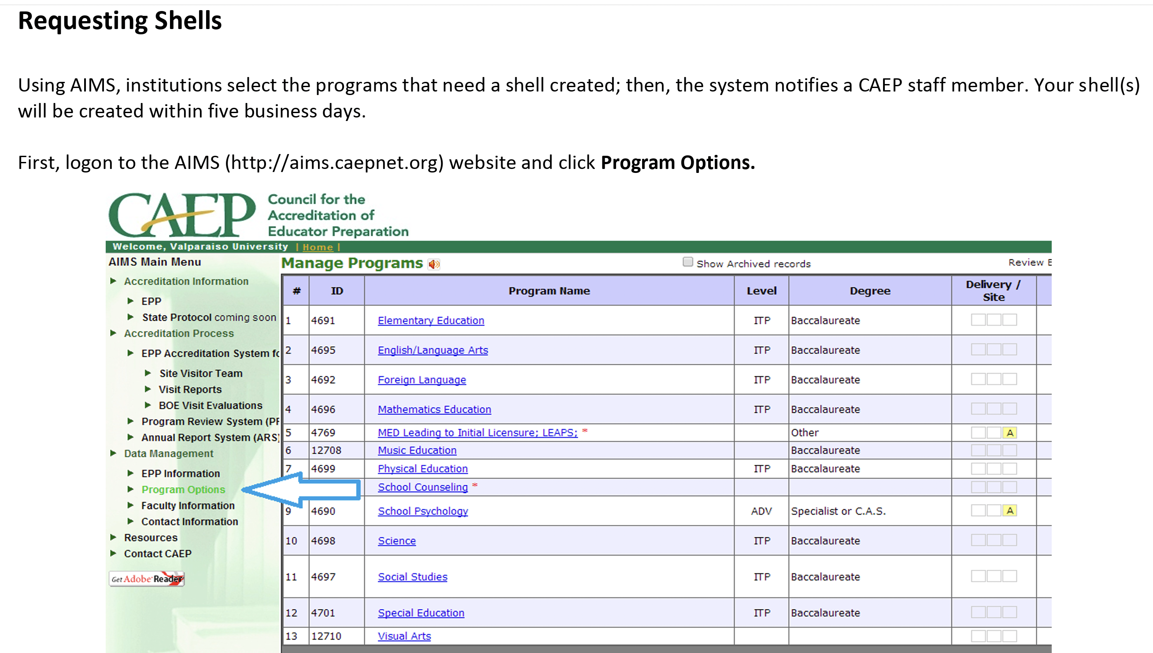
HOW TO REQUEST YOUR TEMPLATES IN AIMS 1.5

Slide 4
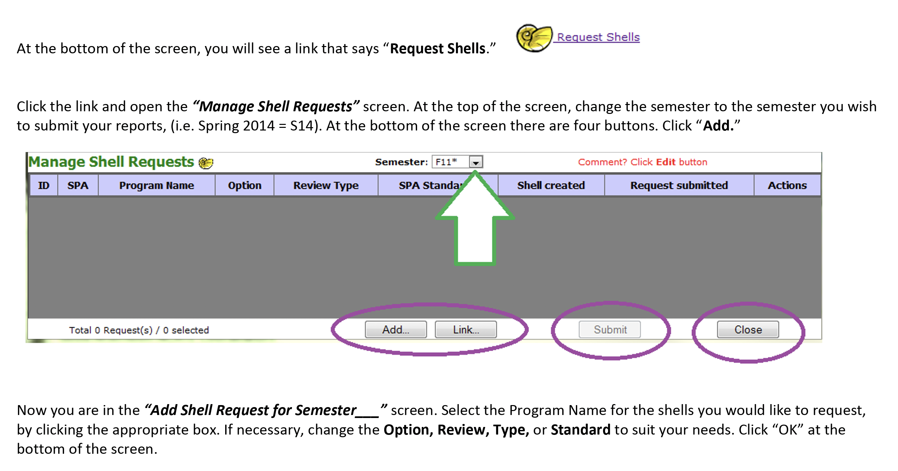
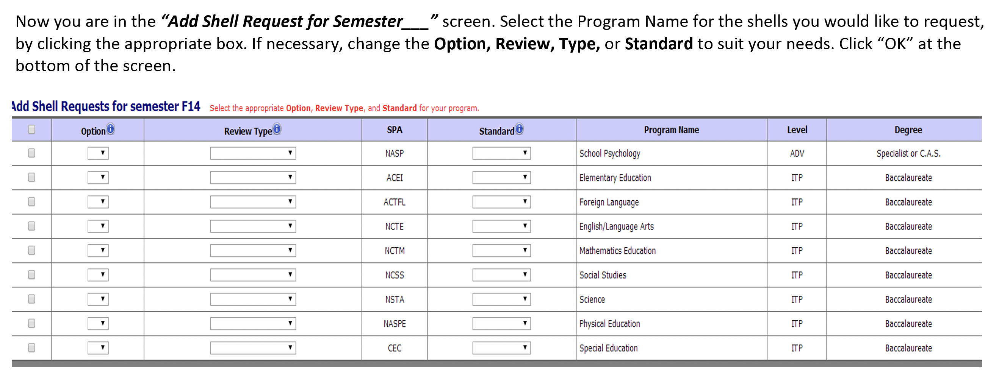
HOW TO REQUEST YOUR TEMPLATES IN AIMS 1.5
(CONTINUED)

Slide 5
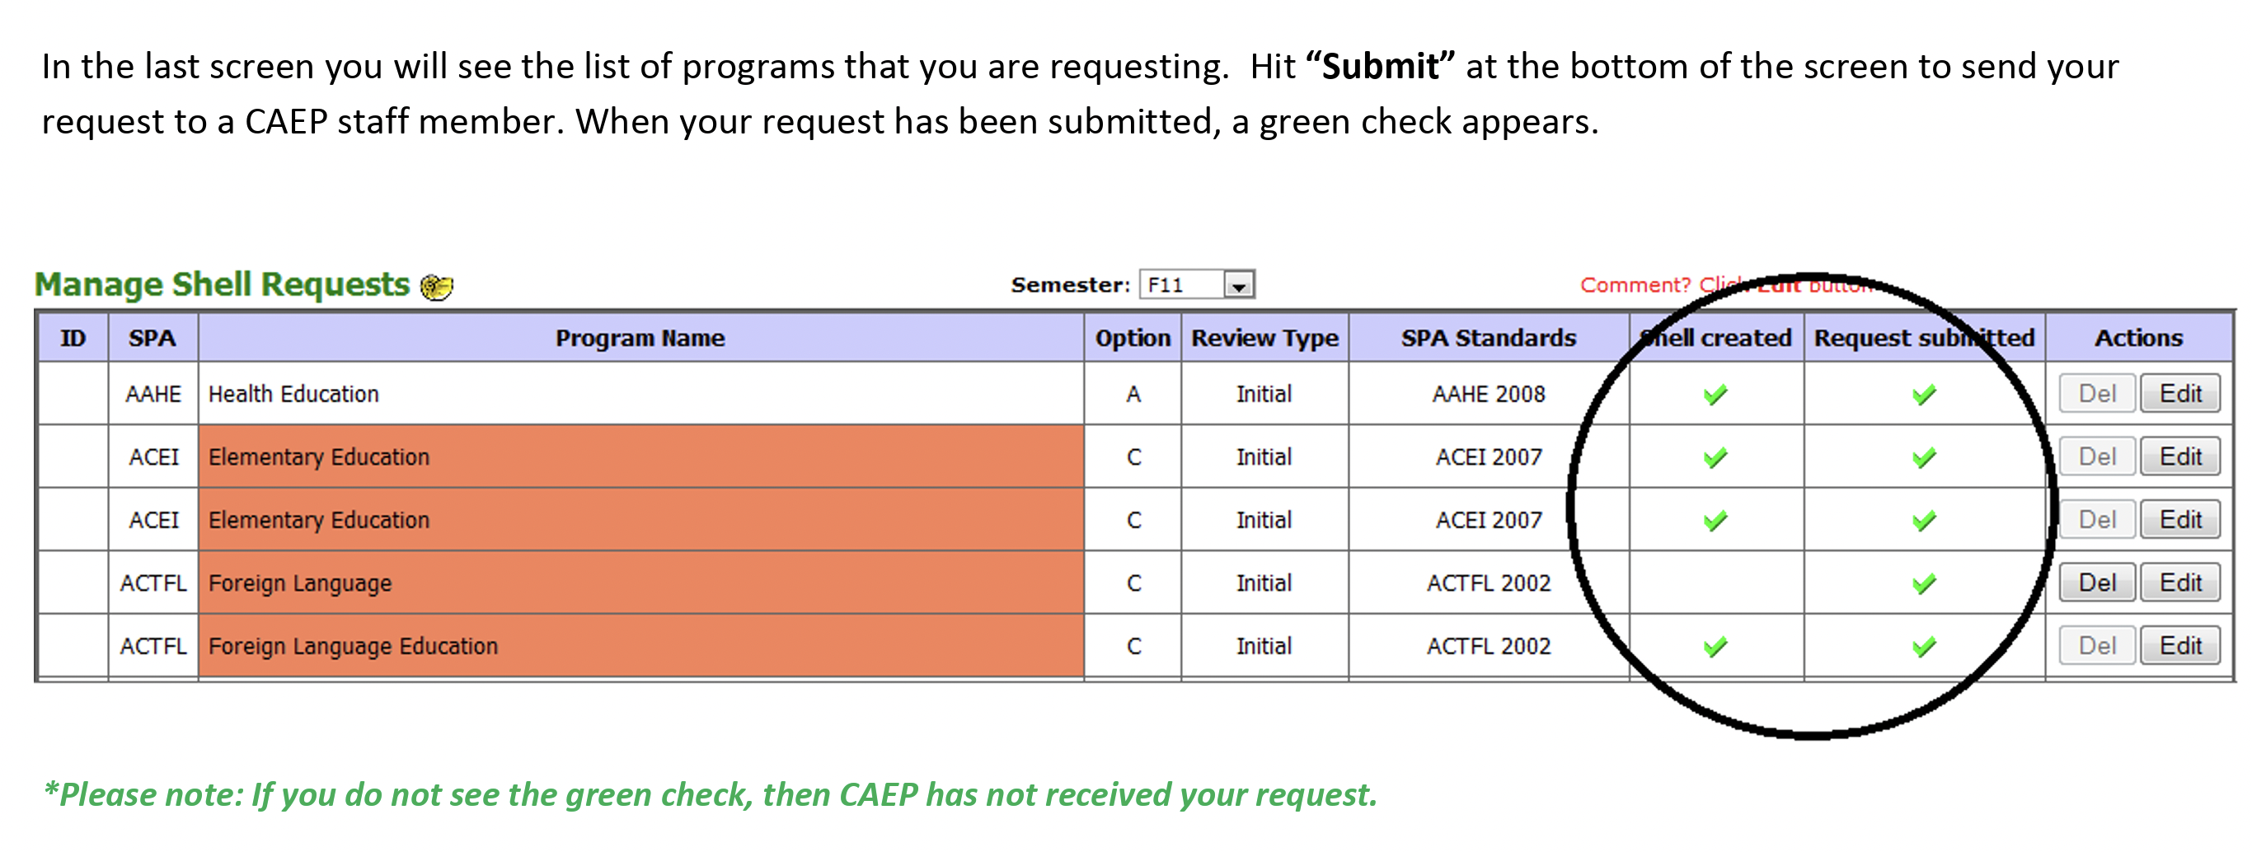
HOW TO REQUEST YOUR TEMPLATES IN AIMS 1.5
(CONTINUED)

